Slide 1

BIG DATA TECHNOLOGY Project
Trending Hashtags

Slide 2

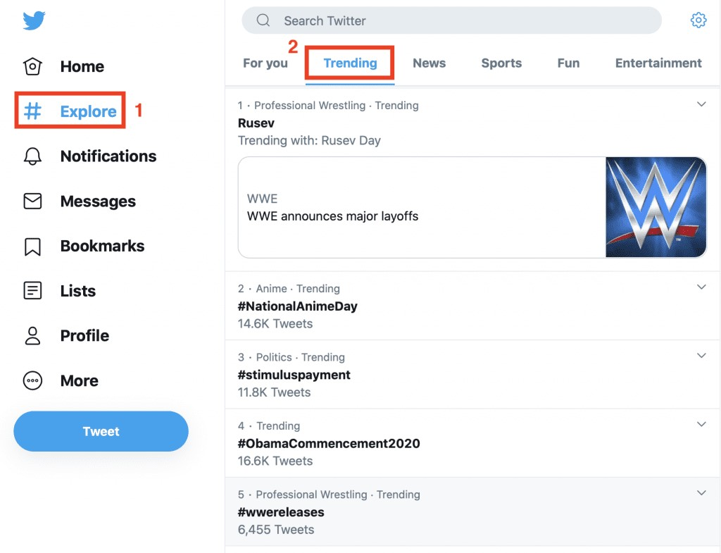
What is trending?
On Twitter, a hashtag or topic that is mentioned at a greater rate than others is said to be a "trending hashtag "or simply a "trend".
Trending hashtags are hashtags that have gone viral.

Slide 3
Project Objective
To create a stream that uses real-time users’ tweets from twitter and persist to Hbase in real-time.
Read top 10 trending hashtags in that consumed tweets in particular period of time and display them in memory for visualization.

Slide 4
Technology Stack
Eclipse
Apache Kafka
Spark Streaming
Apache Hbase
Maven
Twitter Developer account
Dependencies
kafka-clients
hbc-core (Twitter Hosebird client)
spark-streaming
spark-streaming-kafka

Slide 5
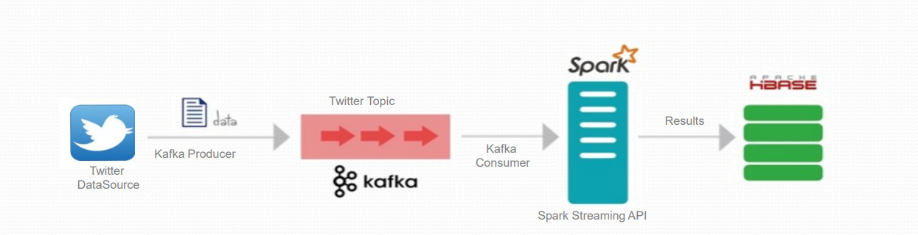
End-to-end Flow Diagram

Slide 6
1. Twitter Data Source
Twitter is widely seen as a useful source of data for many types of social, Information and Communication Technology , and other research as the data it provides is apparently publicly available, accessible easily and free.
For this project twitter real time tweets are taken as source of data

Slide 7
2. Apache Kafka
Apache Kafka is a distributed event store and stream-processing platform.
It’s a power streaming tool for producing and consuming stream of data.
Zookeeper keeps track of status of the Kafka cluster nodes and it also keeps track of Kafka topics, partitions
Kafka Producer API is used to produce streams of data records.
Kafka Consumer API is used to consume a stream of records from Kafka.
Kafka Topic is a stream of records.

Slide 8
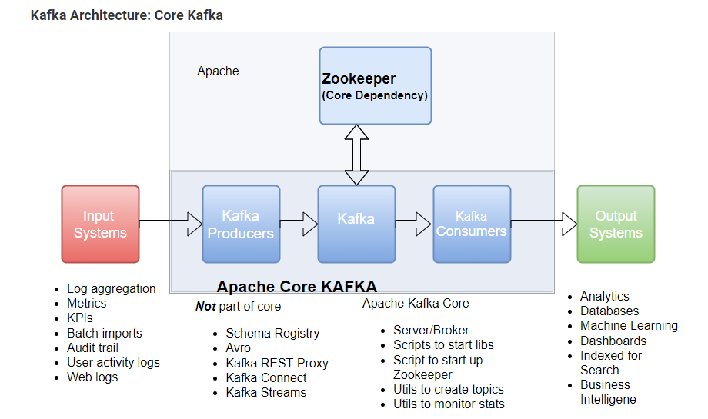

Slide 9
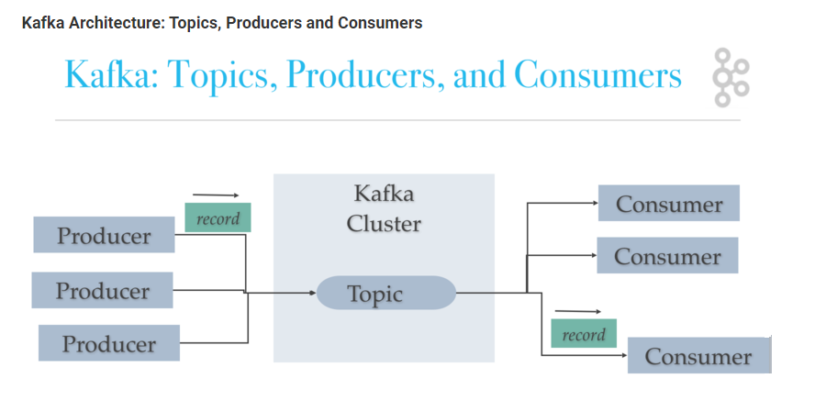

Slide 10
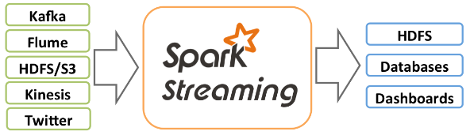
3. Spark
Spark Streaming is an extension of the core Spark API that enables scalable, high-throughput, fault-tolerant stream processing of live data streams. Data can be ingested from many sources like Kafka, Kinesis, or TCP sockets, and can be processed using complex algorithms expressed with high-level functions like map, reduce, join and window.
Spark Streaming receives live input data streams and divides the data into batches, which are then processed by the Spark engine to generate the final stream of results in batches.

Slide 11
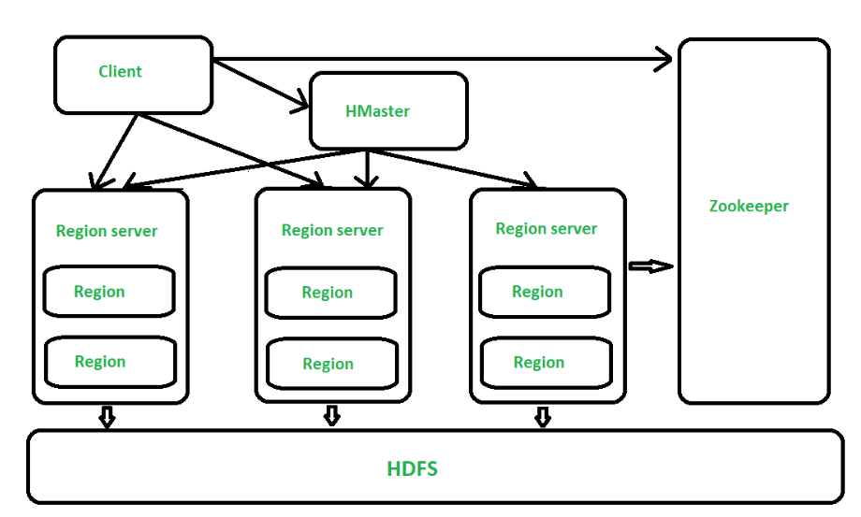
4. Apache HBase
Apache HBase is a scalable, distributed, column-oriented datastore. Apache HBase provides real-time read/write random access to very large datasets hosted on HDFS.

Slide 12
Integrations
Twitter
TwitterProducer
Kafka cluster
SparkKafkaConsumer
HBase
Twitter Data Source and Kafka Integration
Spark and Hbase
Integration

Slide 13
I. Twitter Data Source and Kafka Integration
First install kafka, configure zookeeper and kafka.
Start zookeeper and kafka server
zookeeper-server-start.sh config/zookeeper.properties
kafka-server-start.sh config/server.properties
Then create kafka topic. (“tweet”)
kafka-topics.sh --create --topic tweet --bootstrap-server localhost:9092
Create TwitterProducer and configure twitter client,producer, twitter API keys, access tokens and other.
Runnining this Kafka producer class will ingest data from Twitter API data source and publish it to a Kafka topic(named “tweet”) for consumer application(SparkKafkaConsumer) to consume tweets, listening at that particular topic name .

Slide 14
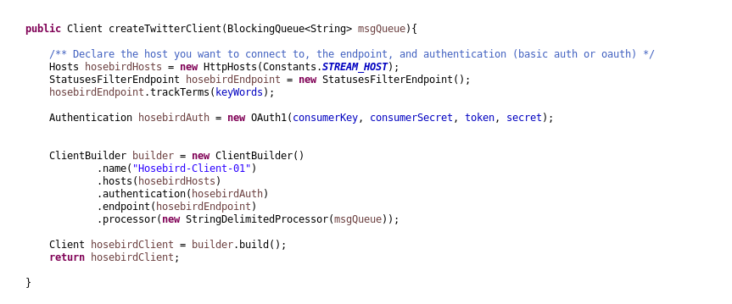
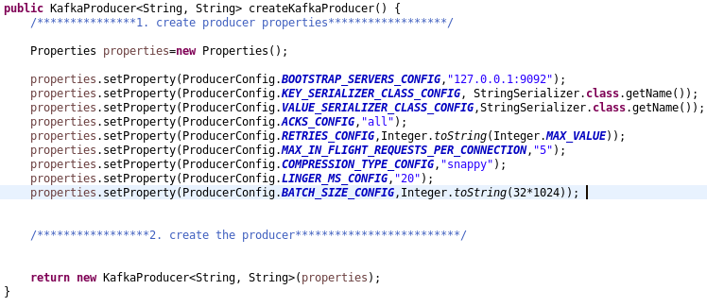
TwitterClient and Producer

Slide 15
II. Spark and Hbase Integration
SparkConsumer ingests stream of data from Kafka topic (“tweet”) into Hbase.
Configure Hbase and Spark.
JavaStreamingContext is set to 20 seconds, time interval at which streaming data will be divided into batches.
So, persisting real-time stream of data will be performed batch by batch.

Slide 16
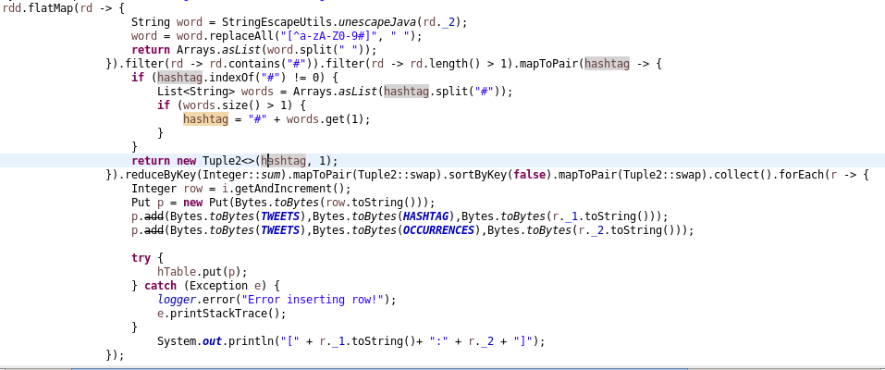
Consume(Spark) Filter(Spark) Persist(Hbase)

Slide 17
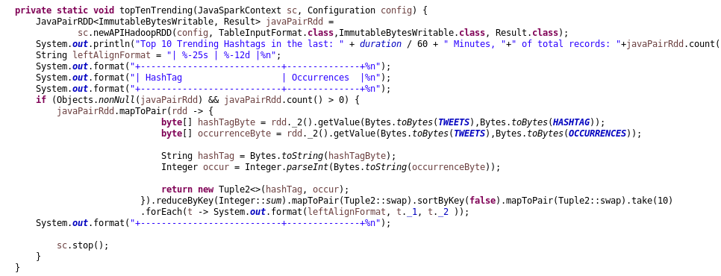
Read Top 10 Hahstags from HBase

Slide 18
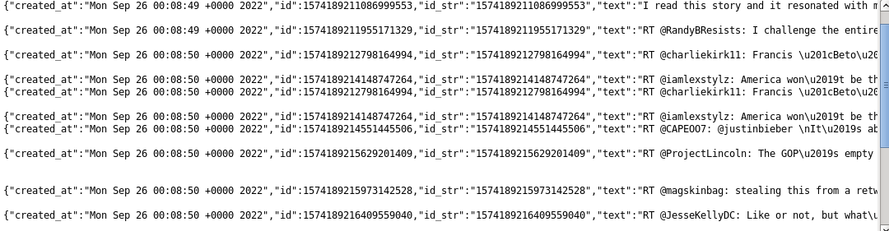
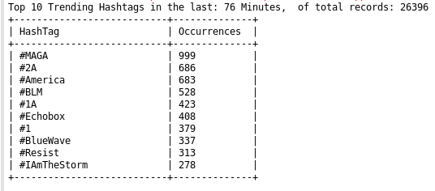
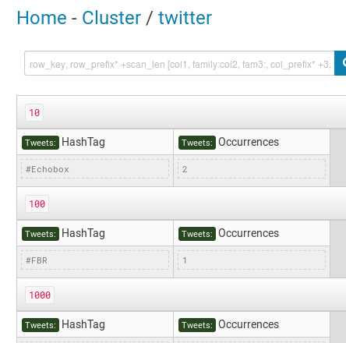

Slide 19
Thank you!
Simon Weldemichael #611098

